Slide 1



Lecture Seven(Spherical Mirrors)
Dr. Sabah Ibrahim Abbas Al-Karkh University
college of Sciences –Medical physics department

Slide 2

Lecture Seven(Spherical Mirrors)
A spherical reflecting surface has image-forming properties similar to those of a thin lens or of a single refracting surface. The image from a spherical mirror is in some respects superior to that from a lens, notably in the absence of chromatic effects due to dispersion that always accompany the refraction of white light. Therefore mirrors are occasionally used in place of lenses in optical instruments, but their applications are not as broad as those of lenses because they do not offer the same possibilities for correction of the other aberrations of the image.

Slide 3

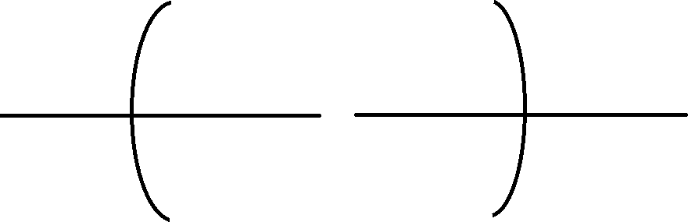













Lecture Seven(Spherical Mirrors)
F
C
C
F
f
f
R
R

Slide 4

Lecture Seven(Spherical Mirrors)
R behind f
The focal length equals one half the radius of curvature
𝑓 = ¹ R
2
The primary and secondary focal points of a mirror coincide in the other it gas one focal point
f (focal length)=+ mirror |  | , R( radius) = - | for concave
f (focal length)= - mirror | , | R(radius)= + | for convex

Slide 5
Lecture Seven(Spherical Mirrors)
Mirror formula
An expression showing the relation between object distance, image distance and focal length of a mirror is called the mirror formula. To derive the formula following assumptions and sign conventions are made.
The following is a simple derivation of the formula giving the conjugate
relations for a mirror
(1) Distances measured from left to right are positive while those measured from right to left are negative.
(2) Incident rays travel from left to right and reflected rays from right to left.
(3) The focal length is measured from the focal point to the vertex. This gives f
a positive sign for concave mirrors and a negative sign for convex mirrors.
(4) The radius is measured from the vertex to the center of curvature. This makes R negative for concave mirrors and positive for convex mirrors.
(5) Object distances s and image distances s' are measured from the object and from the image respectively to the vertex. This makes both sand s' positive and the object and image real when they lie to the left of the vertex; they are negative and virtual when they lie to the right.

Slide 6















Lecture Seven(Spherical Mirrors)
a
Point object
u’
u
c
s

Slide 7
Lecture Seven(Spherical Mirrors)
By using the reflection law
𝜑 = 𝜑
•
External angle for triangle pca
•
𝜑 = 𝑢 + 𝜃 (1)
𝑢 = 𝜑 + 𝜃 → 𝜑 = 𝑢 𝜃 (2)
𝑢 + 𝜃 = 𝑢 𝜃
𝑢 𝑢 = 2𝜃 (3)

Slide 8
Lecture Seven(Spherical Mirrors)
1 ₊ 1 ₌ −2
𝑆 𝑆 𝑅
𝑇𝑕𝑒 𝑆𝑝𝑕𝑒𝑟𝑖𝑐𝑎𝑙 𝑚𝑖𝑟𝑟𝑜𝑟 𝑓𝑜𝑟𝑚𝑢𝑙𝑎
For plane mirror 𝑅 = ∞ then the mirror formula became
¹ + ¹ = ∞ → 𝑠 = 𝑠
𝑆 𝑆
Notes:
Plane mirror: if real object it has virtual image and erect with the
same size to the object.
Convex mirror: if real object it has virtual, erect, miniature image.
Concave mirror: if real object it has real virtual image, miniature or
magnifying, erect or inverted depending on object position.

Slide 9
Lecture Seven(Spherical Mirrors)
Gaussian formula for spherical mirror:
The general formula:
𝑠 𝑠 𝑅
When an object at infinity
•
•
1 ₊ 1 ₌ −2
1 ₊ 1 ₌ −2
∞ 𝑓 𝑅 1 ₌ −2
𝑓 𝑅
1 ₊ 1 ₌ 1
𝑆 𝑆 𝑓
•
𝑖𝑠 𝑡𝑕𝑒 𝑔𝑎𝑢𝑠𝑠𝑖𝑎𝑛 𝑓𝑜𝑟𝑚𝑢𝑙𝑎 𝑓𝑜𝑟 𝑚𝑖𝑟𝑟𝑜𝑟

Slide 10

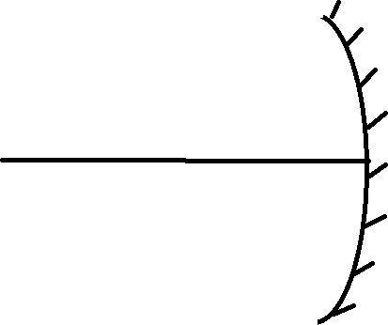









Lecture Seven(Spherical Mirrors)
The lateral magnification image of the mirror :
M
y
c
Q
M’
y ’
Q’
S’
s

Slide 11


Lecture Seven(Spherical Mirrors)
The magnification
equation relates the ratio of the image
distance and object distance to the ratio of the image height (𝑦) and object height (𝑦 )The magnification equation is stated as follows:
Reflection law
𝜑 = 𝜑
•
𝑀 = 𝑚𝑎𝑔𝑛𝑖𝑓𝑖𝑐𝑎𝑡𝑖𝑜𝑛 = ^{𝑦} = ^{𝑠}
The Power of a Mirror is given by equation :
𝑃 =
𝑦 ₌ 𝑦
for small angle
𝑠 𝑠
𝑦 𝑠
1 ₌ 2 ₌ 1 ₊ 1
𝑓 𝑅 𝑠 𝑠

